Slide 1
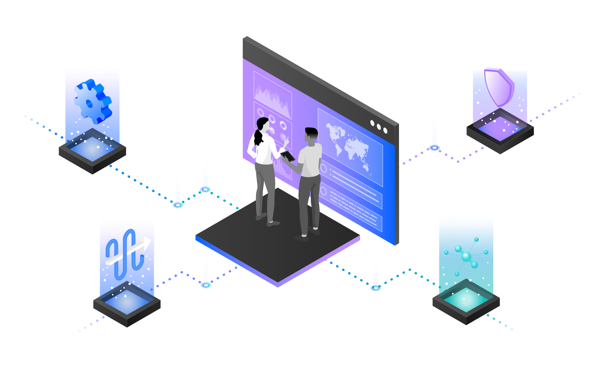
IBM Cloud Pak for Integration
Automate customer interactions using APIs and Integration Demo
—
First Lastname Job Title
Notes:
Today we will demonstrate how CloudPak for Integration automate customer interactions using APIs and Integration Demo.

Slide 2


Customer Satisfaction Matters!
Automating Customer Interactions can:
Drive additional revenue
Reduce costs
remove manual steps, data entry into multiple different applications, and potential errors and delays
happy customers buy more; disappointed customers look for alternatives.
Notes:
Automating customer interactions can provide the difference between a satisfied customer who wants to do more business with you or a disappointed customer who is looking for an alternative option. In addition, it can remove manual steps, data entry into multiple different applications, and potential errors and delays – all of which are additional costs to your business.

Slide 3
Automate customer interactions using APIs and Integration
This demo automates a series of steps using APIs and Integration to:
Obtain and validate input information from a customer with a concern,
Open a case in Salesforce,
Attach the incoming information to the case,
Analyze the tone of the situation, and
Respond to the customer with the case number and expected date for resolution:
Notes:
This demo is about how to automate customer interactions. To implement this automation, we will use both APIs and integrations to back-end applications. The demo scenario is related to a car repair, but this is just an example. The same techniques are applicable to your environment in support of your customers.
This demo automates a series of steps to: obtain and validate input information from a customer with a concern, open a case in Salesforce, attach the incoming information to the case, analyze the tone of the situation, and respond to the customer with the case number and expected date for resolution.

Slide 4
Demonstration Agenda
02
Importing and Reviewing the Flow
04
Creating the Integration Server
06
Working with Developer Portal
01
Accessing the Cloud Pak for Integration
03
Testing the Solution
05
Managing APIs
Notes:
In the demo we will execute the following steps: - Access the Cloud Pak for Integration environment and explore the capabilities - Import and review the automated customer interactions integration flow - Test the flow - Deploy the flow into the Cloud Pak runtime environment - Manage access to the flow as an API and set up the security and rate limits - Demonstrate how a developer can use the API Portal to perform self-service consumption of the API Let’s get started!

Slide 5

Demonstration
Notes:
See script documentation for assistance in demo execution

Slide 6
Demonstration Summary
In this demo we:
Accessed the Cloud Pak for Integration environment and explored the capabilities
Imported and reviewed the automated customer interactions integration flow
Tested the flow
Deployed the flow into the Cloud Pak runtime environment
Managed access to the flow as an API and set up the security and rate limits
Demonstrated how a developer can use the API Portal to perform self-service consumption of the API
From a business perspective we used APIs and application integrations to automate a series of steps to satisfy our customer’s request – without delay – hopefully creating a satisfied customer!
Notes:
Let’s summarize what we’ve done today. In the demo we: - Accessed the Cloud Pak for Integration environment and explored the capabilities - Imported and reviewed the automated customer interactions integration flow - Tested the flow - Deployed the flow into the Cloud Pak runtime environment - Managed access to the flow as an API and set up the security and rate limits - Demonstrated how a developer can use the API Portal to perform self-service consumption of the API From a business perspective we used APIs and application integrations to automate a series of steps to: obtain and validate input information from a customer with a concern, open a case in Salesforce, attach the incoming information to the case, analyze the tone of the situation, and respond to the customer with the case number and expected date for resolution. The customer expressing a concern or needing assistance obtains rapid response to their interaction and the confidence that your business is handling their request.

Slide 7
Thank you
First Lastname
Job Title
—
firstlastname@us.ibm.com
+1-555-666-5555
ibm.com
© Copyright IBM Corporation 2021. All rights reserved. The information contained in these materials is provided for informational purposes only and is provided AS IS without warranty of any kind, express or implied. Any statement of direction represents IBM’s current intent, is subject to change or withdrawal, and represent only goals and objectives. IBM, the IBM logo, ibm.com and IBM Automation are trademarks of IBM Corp., registered in many jurisdictions worldwide. Red Hat® and OpenShift® are trademarks or registered trademarks of Red Hat, Inc. or its subsidiaries in the United States and other countries. Other product and service names might be trademarks of IBM or other companies. A current list of IBM trademarks is available at Copyright and trademark information.
IBM Integration / © 2020 IBM Corporation
7
Notes:
Thank you!

Slide 8
8

Slide 9
Backup Slides

Slide 10


IBM Cloud Pak for Integration
Client & Partner Applications
Shared asset
repository
Unified governance framework
API management
Application integration
End-to-end security
Enterprise messaging
Event streaming
High speed data transfer
AI and machine learning
Robotic Process Automation
Natural language interactions
Process mining
Event detection
Machine learning
3rd Party integrations
Operational models
IBM Automation foundation
Robotic Process Automation
Natural language interactions
Process and task mining
Event detection
Machine learning
3rd Party integrations
Operational models
IBM Cloud
AWS
Microsoft Azure
Google Cloud
VMware
Private
IBM Z IBM LinuxOne IBM Power Systems
End points
IBM Integration / © 2021 IBM Corporation
10
Notes:
NOTE: Use this slide if you want to give a product overview and describe the capabilities presented in this demo.
IBM Cloud Pak for Integration is a hybrid integration platform with an automated, closed-loop approach that supports multiple styles of integration within a single, unified experience. This Demo demonstrates how Cloud Pak for Integration automates customer interactions using APIs and Integration. In this demo, you will see the API Management, Application Integration and End-to-end security capabilities in action.

Slide 11
Demonstration Scenario Car Repair Company
We are a Car Repair company: We take in vehicles with problems and repair them – seems simple but…
We want to gain business advantage by allowing multiple car leasing companies to use us to repair their cars – these companies insist that we expose APIs for them to call to do business with them.
We want to allow their customers to book their cars in for repair and get an estimate for price and number of days in real time – in seconds.
We want to allow them to send photos of their cars so we can check for type, damage etc.
We want to check for errors and issues up-front as quickly as possible to feed back to the customer in real time.
We want to minimize manual processes and have the repair request automatically create a repair case in our CRM system (Salesforce).
Notes:
NOTE: Use this slide if you want to give an overview about the Demo Scenario
This demo is about how to automate customer interactions. To implement this automation, we will use both APIs and integrations to back-end applications. The demo scenario is related to a car repair, but this is just an example. The same techniques are applicable to your environment in support of your customers.
In this demo:
We are a Car Repair company: We take in vehicles with problems and repair them – seems simple but…
We want to gain business advantage by allowing multiple car leasing companies to use us to repair their cars – these companies insist that we expose APIs for them.
We want to allow their customers to book their cars in for repair and get an estimate for price and number of days in real time.
We want to allow them to send photos of their cars so we can check for type, damage etc.
We want to check for errors and issues up-front as quickly as possible to feed back to the customer in real time.
We want to minimize manual processes and have the repair request automatically create a repair case in our CRM system (Salesforce).

